Slide 1
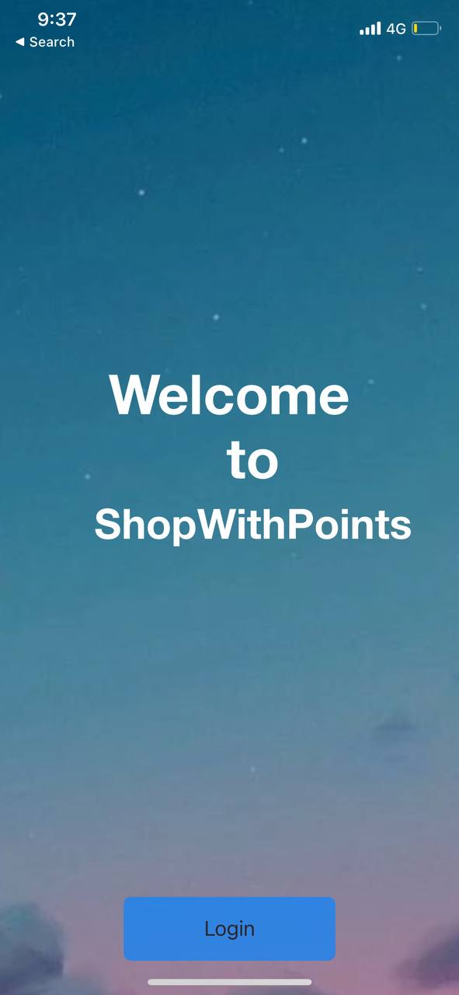
Shop With Points
Alireza Samadifardheris
Ashkan Ansarifard
Notes:
Ashkan

Slide 2


Content
Why Shop With Points?
Functional Point & COCOMOII
Sprints
The Idea
Features
User Stories
Wireframe by Balsamiq
Notes:
Ashkan ( 7 minutes till END OF FP

Slide 3

Content
Docker
References
Technologies
Demo
Notes:
Alireza 5

Slide 4
Why Shop With Points?
Functional Point & COCOMOII
Sprints
The Idea
Features
User Stories
Wireframe by Balsamiq
Notes:
Ashkan

Slide 5
The Idea
User Profiles
Clients will be able to create User Profiles
Your points Wallet
Business Profiles
Businesses will be able to create Business Profiles
Shop and Make reviews
Search shops and go shopping and leave reviews about you experience
$
$
Obtain coins
$
For each of your reviews obtain coins
Use your coins in the shops
Next time you go shopping, use your coins to get discounts and rewards
Notes:
We here have developed a quite simple app with a significant impact for the businesses.
As you know, the number of small businesses have increased rapidly (thanks to our buddy COVID-19).
With our app, a customers and businesses are linked together strongly in way that both can be benefitial.
Our app can be used as simple as you can see:
Go to a store
Shop
Share your experience and make a review
Gain 1 coin per review
Go back shopping and show your unique QR code. and use your coins to get rewards and discounts

Slide 6
Why Shop With Points?
Functional Point & COCOMOII
Sprints
The Idea
Features
User Stories
Wireframe by Balsamiq
Notes:
Ashkan

Slide 7
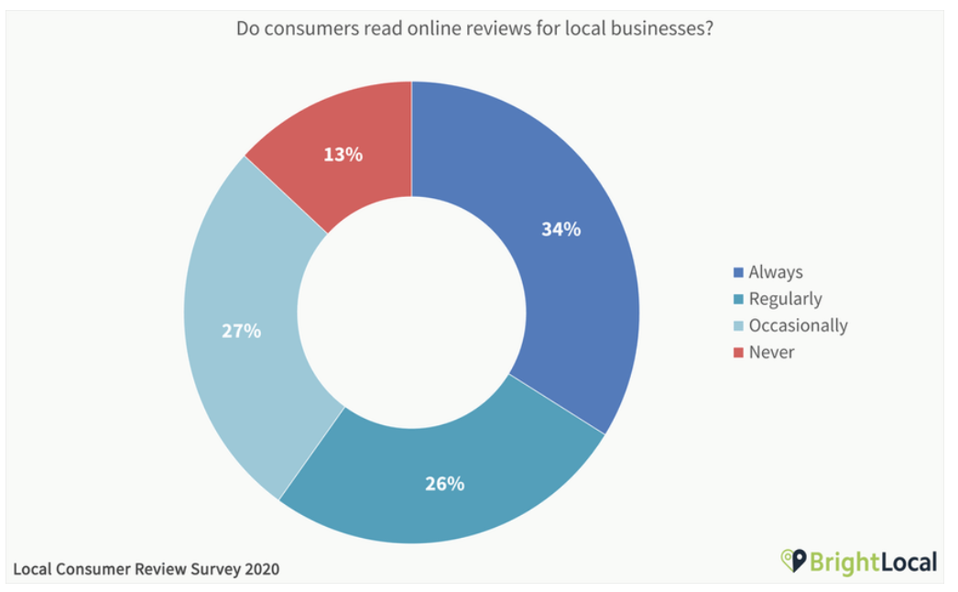
Why Shop With Points?
Notes:
But why do we need it?
Well, Reviews are one of the most influential factors on your online reputation – they make up 10% of criteria for how Google displays results, and can have a substantial impact on potential customers’ perspectives of your business, with 87% of consumers looking to online reviews to learn more about local businesses in 2020.
Many prospective customers determine whether or not they will frequent a business based on reviews, before ever interacting with the business itself. 79% of users report trusting online reviews as much as personal recommendations from friends or family.

Slide 8
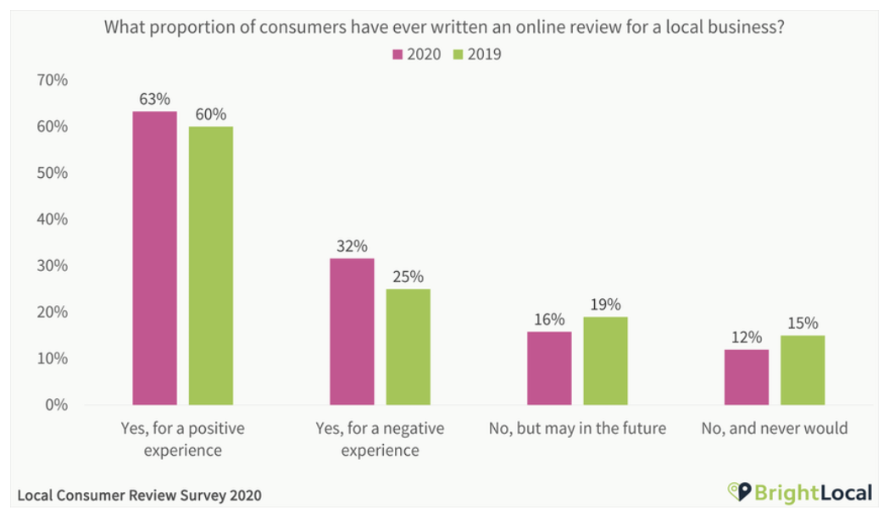
Why Shop With Points?
Notes:
And here, we see how much people are willing to write down reviews for a positive or a negative experience. And as you can see it is increasingly quite gradually.

Slide 9
Why Shop With Points?
To see your business from users’ point of view
To have a low price but highly intriguing advertisement
Businesses
Shop With Points
Users
To be an incentive for the customers to make a purchase
To motivate customers to leave a proper review
Notes:
So, shopswithPoint provide this solution that businesses do need that their customers put a little of their time in order to make a review. And as a result, obtain coins which can be later used for their shopping

Slide 10
Why Shop With Points?
Functional Point & COCOMOII
Sprints
The Idea
Features
User Stories
Wireframe by Balsamiq
Notes:
Ashkan

Slide 11
Features
Businesses
Users
Log in with verified Business Account
1
1
Create User Account
Check the users coins
2
2
View Businesses on map (table)
Redeem users coins
3
3
Leave Reviews+score
4
Earn Coins
5
Use Your Coins
6
See reviews of others for businesses
Notes:
Ashkan

Slide 12
Why Shop With Points?
Functional Point & COCOMOII
Sprints
The Idea
Features
User Stories
Wireframe by Balsamiq
Notes:
Ashkan

Slide 13
Sprints
#Sprint | Sprint goal | Problems | Sprint status | Start Date | End Date
Sprint 1 | 1)Analysis 2)Estimation | …. | Done | 2022-05-02 | 2022-05-12
Sprint 2 | Complete UI&UX , Start app development for user logins | … | Done | 2022-05-16 | 2022-05-27
Sprint 3 | Complete UI&UX , Start app development for user logins | The fundamental part of development | Done | 2022-05-30 | 2022-06-10
Sprint 4 | complete business view-complete app-complete documentation | Overlapping with exams specially software engineering exam | Done | 2022-06-13 | 2022-06-22

Slide 14
Sprint1 as an Example
Sprint 1
Sprint Planing & Demo: 2021-05-01
Start Sprint: 2022-05-02
End Sprint: 2022-05-12
Sprint Goal: Analysis & Estimation
 |  | Attendance Percentage | 1 | 1 |  | 6 hours/day
 |  | Name | Alireza | Ashkan | Total hours | Optimal Hour
0 | Day | 0 | 54 | 54 | 108 | 108.00
1 | Mon | 2022-05-02 | 49.5 | 49.5 | 99 | 96.00
2 | Theu | 2022-05-03 | 44.5 | 44.5 | 89 | 84.00
3 | Wed | 2022-05-04 | 39.5 | 39.5 | 79 | 72.00
4 | Thurs | 2022-05-05 | 34 | 35.5 | 69.5 | 60.00
5 | Fri | 2022-05-06 | 30 | 35.5 | 65.5 | 48.00
6 | Mon | 2022-05-09 | 26 | 32 | 58 | 36.00
7 | Tue | 2022-05-10 | 21 | 30 | 51 | 24.00
8 | Wed | 2022-05-11 | 15 | 24 | 39 | 12.00
9 | Thu | 2022-05-12 | 9 | 18 | 27 | 0.00
 |  | Attendance Percentage | 1 | 1 |  |  |  |  |  |  |  | Task owner
 |  | Name | Alireza | Ashkan | Total hours |  |  |  |  | Task Title |  | Alireza | Ashkan
1 | Mon | 2022-05-02 | 4.5 | 4.5 | 9 |  | Day | Total hours |  | Find similar system |  | 1
2 | Tue | 2022-05-03 | 5 | 5 | 10 |  | 0 | 108 |  | Analysis other App |  | 1
3 | Wed | 2022-05-04 | 5 | 5 | 10 |  | 9 | 0 |  | Estimation FP |  |  | 1
4 | Thu | 2022-05-05 | 5.5 | 4 | 9.5 |  |  |  |  | Estimation CoCoMo |  |  | 1
5 | Fri | 2022-05-06 | 4 | 0 | 4 |  |  |  |  | Find Lang and structure |  |  | 1
6 | Mon | 2022-05-09 | 4 | 3.5 | 7.5 |  |  |  |  | create draft ux |  | 1
7 | Tue | 2022-05-10 | 5 | 2 | 7 |  |  |  |  | create user stories |  |  | 1
8 | Wed | 2022-05-11 | 6 | 6 | 12 |  |  |  |  | create balsamiq |  | 1
9 | Thu | 2022-05-12 | 6 | 6 | 12
A brief report

Slide 15
Why Shop With Points?
Functional Point & COCOMOII
Sprints
The Idea
Features
User Stories
Wireframe by Balsamiq
Notes:
Ashkan

Slide 16
User Stories
Column1 | EPIC | USER STORY | COMPLEXITY | PRIORITY | BUSSINESS VALUE
Bussiness | Create an Owner Account | As an owners of businesses, I can create a bussiness (with verification) | 1 | 1 High | 1
Bussiness | Add Your Owner Profile | As an owners of businesses, I can add my location and a description of my business | 1 | 1 High | 1
Bussiness | Scan customer's QR | As an owners of businesses, I can scan each customers QR code | 2 | 1 High | 1
Bussiness | Multiple QR scanning | As an owner, I can re-try the QR code scanning if I loose connection | 3 | 2 Med | 2
Bussiness | Log-out procedure | As an owners of businesses, I can logout of my account | 1 | 3 Low | 3
Bussiness | Make use of the coins | As an owners of businesses, I can redeem a certain number of customers coins | 2 | 1 High | 1
Client | Registeration | As a normal user, I can register for the application by email | 1 | 1 High | 1
Client | Log in with gmail | As a guest user, I can log in with my google account | 2 | 1 High | 1
Client | Username-password log in | As a registered user, I can log in with username and password | 2 | 3 Low | 3
Client | Businesse as tables | As a registered user, I can see businesses as a table | 1 | 2 med | 2
Client | Businesses in map | As a registered user, I can see businesses on the map near me | 1 | 3 Low | 3
Client | Log-out procedure | As a registered user, I can logout of the application from my account | 1 | 3 Low | 1
Client | Coin Management | As a normal client, I can see and manage my wallet | 2 | 2 Med | 3
Client | Coin uses | I can give coins for rewards | 1 | 1 High | 3
Client | Client QR code | As a normal client, I can have a 1 minute valid QR code to use my coins | 3 | 3 Low | 1
Client | All the reviews at one place | As a normal client, I can see other reviews for a business | 2 | 3 Low | 3
Client | Average score of reviews | As a normal client, I can see an average of reviews of a business | 2 | 2 Med | 2
Client | Write a review with score | As a normal client, I can write reviews and score | 3 | 1 High | 1
Client | Re-create QR code multiple times | As a normal client, I can re-create QR codes as much as I want | 3 | 3 Low | 1
Notes:
Ashkan

Slide 17
Why Shop With Points?
Functional Point & COCOMOII
Sprints
The Idea
Features
User Stories
Wireframe by Balsamiq
Notes:
Ashkan

Slide 18
General System Characteristic
No. |  | VAF | Weight: 0 (low) ~ 5 (high)
1 | Data communications |  | 4
2 | Distributed data processing |  | 3
3 | Performance |  | 4
4 | Heavily used configuration |  | 3
5 | Transaction rate |  | 4
6 | On-Line data entry |  | 5
7 | End-user efficiency |  | 4
8 | On-Line update |  | 4
9 | Complex processing |  | 3
10 | Reusability |  | 4
11 | Installation ease |  | 4
12 | Operational ease |  | 4
13 | Multiple sites |  | 2
14 | Facilitate change |  | 4
 |  | VAF | 52
Notes:
A table of 14 aspect of which we we will sum up and these will be used to calculate our complexity adjustment factor (CAF = 0.65 + (0.01*sum1-14))

Slide 19
Function Points
 |  |  |  |  |  |  |  | Unadjusted FP |  | 66
 |  |  |  |  |  |  |  | Adjusted FP |  | 77.22
No. | Module | Function Name | Description | Type | DET | RET / FTR | Complexity | FP | Adjust % | FP adjusted
1 | welcome page | start |  | EQ | 1 | 1 | Low | 3 |  | 3
2 | log in/sign up | log in |  | EI | 2 | 1 | Low | 6 |  | 6
5 | map view | wallet |  | EQ | 4 | 2 | Low | 3 |  | 3
6 | map view | recenter |  | EQ | 1 | 1 | Low | 3 |  | 3
7 | map view | pin | shows business summary | EQ | 1 | 1 | Low | 3 |  | 3
8 | map view | business name |  | EQ | 1 | 5 | Average | 4 |  | 4
9 | wallet view | sign out |  | EI | 1 | 1 | Low | 3 |  | 3
10 | wallet view | back |  | EI | 1 | 1 | Low | 3 |  | 3
11 | busniess view | back |  | EI | 1 | 1 | Low | 3 |  | 3
12 | busniess view | review |  | EI | 1 | 1 | Low | 3 |  | 3
15 | review | submit | text input+score | EO | 3 | 2 | Low | 4 |  | 4
16 | review | back |  | EI | 1 | 1 | Low | 3 |  | 3
17 | review fail | ok |  | EI | 1 | 1 | Low | 3 |  | 3
18 | review submitted | ok |  | EI | 1 | 1 | Low | 3 |  | 3
19 | business owner view | sign out |  | EI | 1 | 1 | Low | 3 |  | 3
20 | business owner view | open camera |  | EI | 1 | 1 | Low | 3 |  | 3
21 | camera | scan qr code |  | EQ | 1 | 1 | Low | 3 |  | 3
22 | camera | back |  | EI | 1 | 1 | Low | 3 |  | 3
23 | redeem view | back |  | EI | 1 | 1 | Low | 3 |  | 3
24 | redeem view | confirm | select points and confirm | EO | 2 | 1 | Low | 4 |  | 4
Notes:
Notice that our application does not have EIF (External Interface file) because it is not interacting with any other applications

Slide 20
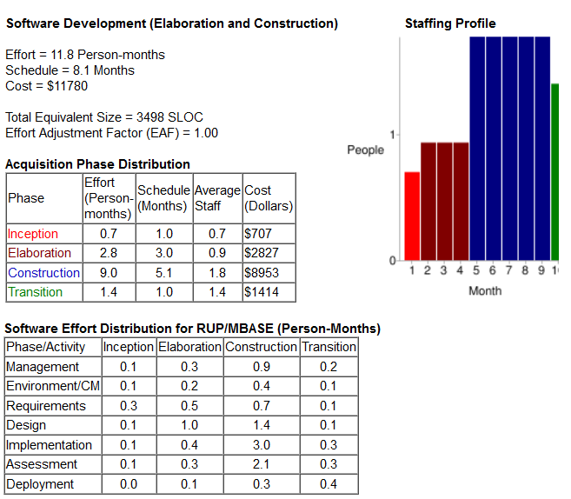
COCOMOII (Estimation)
Estimated with Function Point
Notes:
Ashkan

Slide 21
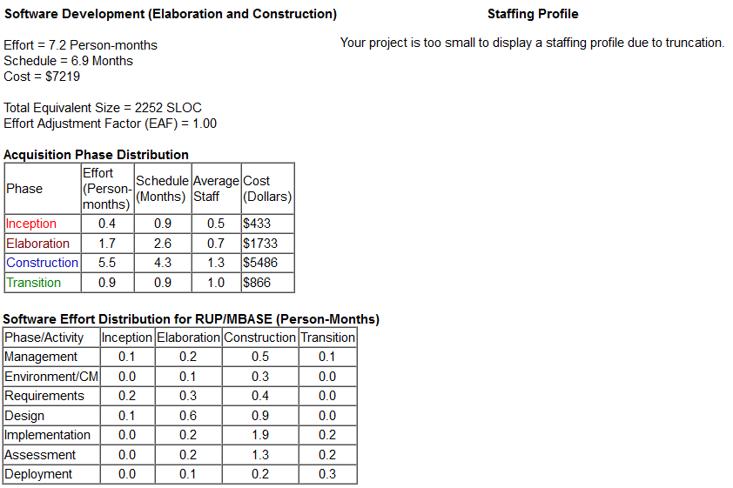
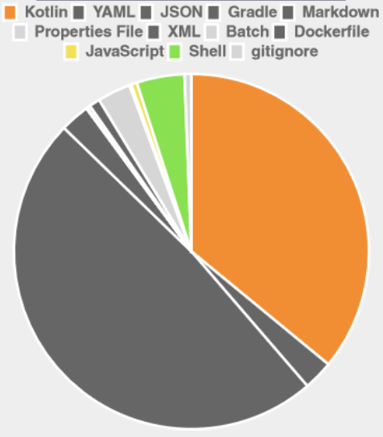
COCOMOII (Actual)
Files | Lines | Blanks | Comments | Lines of Code
48 | 2622 | 220 | 150 | 2252
Estimation based on actual lines of codes
Notes:
Ashkan

Slide 22
Why Shop With Points?
Functional Point & COCOMOII
Sprints
The Idea
Features
User Stories
Wireframe by Balsamiq
Notes:
Alireza

Slide 23
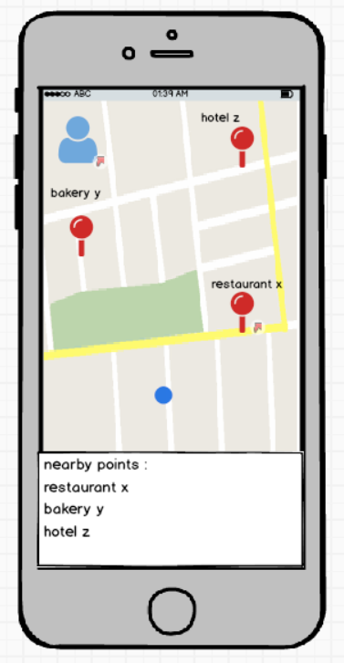
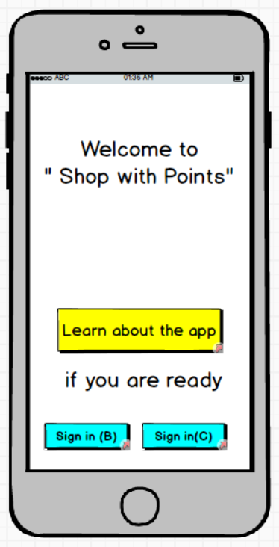
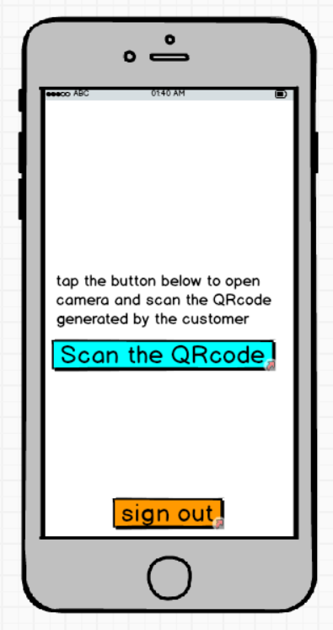
Wireframe by Balsamiq
Notes:
As the the initial step of our app development we put user stories that we intented to put in our very first version into balsamique userinterface mockups.. For example here after some tests and modifications, these are some final views for the app either for normal log in, in the middle, partner side, and on the left side we can a one of views in noral user side. The map view, with location of the restaurants, as well as their names on a table.

Slide 24
Docker
References
Technologies
UI and UX

Slide 25








Technologies

Slide 26
Docker
References
Technologies
UI and UX

Slide 27
Docker

Slide 28
Docker
References
Technologies
Demo

Slide 29
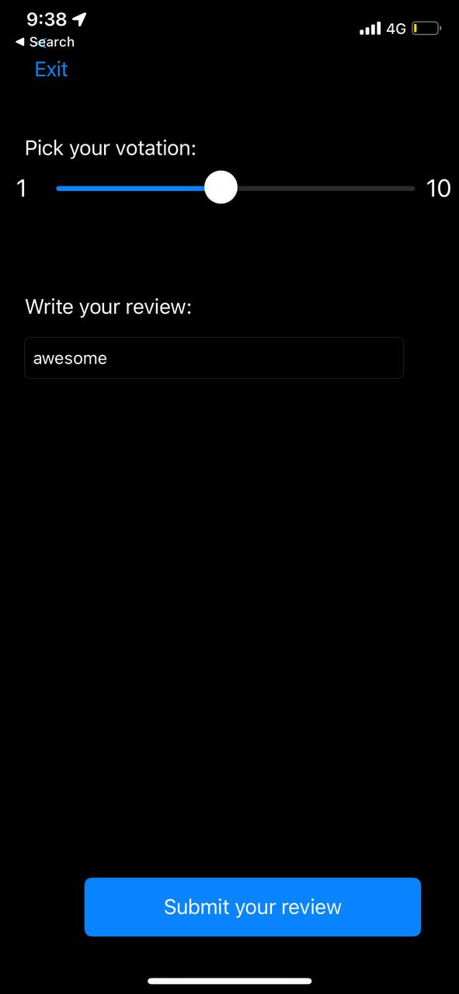
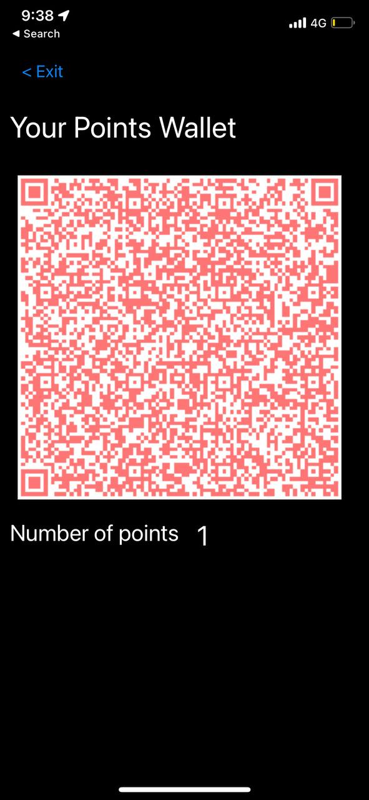
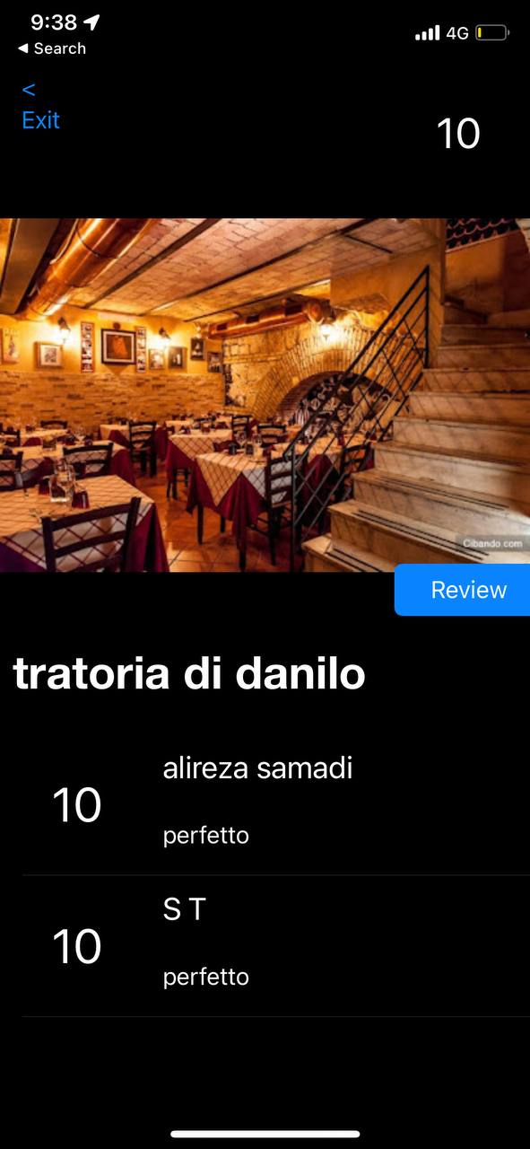
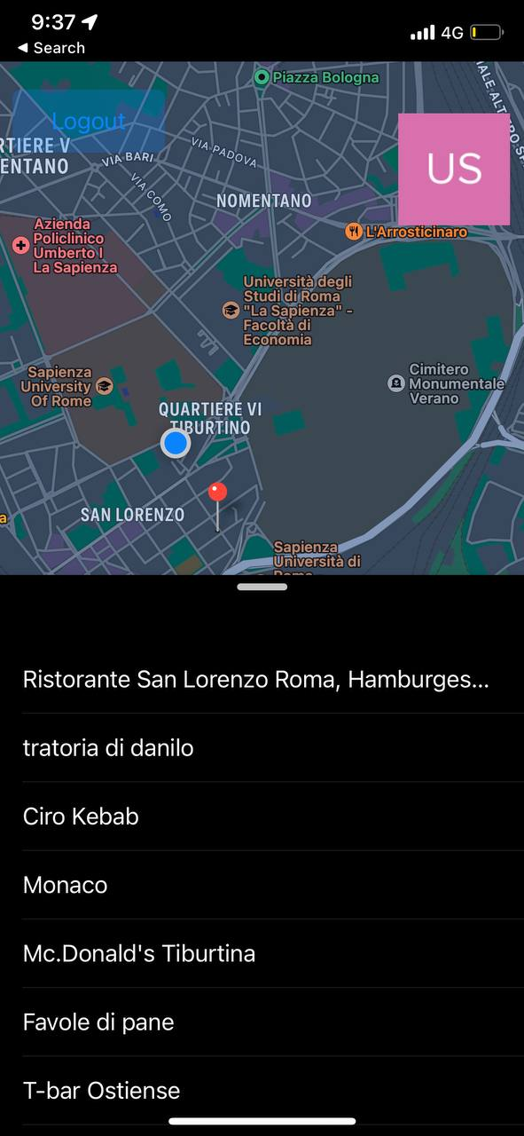
UI and UX (Demo)+Postman
Notes:
Ashkan

Slide 30
Docker
References
Technologies
Demo

Slide 31
References
MASSIMO MECELLA | Catalogue Of Study Programs
Oracle JAVA8 Documentations
Docker Documentations
Mongodb Documentations
http://softwarecost.org/tools/COCOMO/
All the documents can be accessed from the GitHub:
https://github.com/alirezasamadii/ShopwithPoints
Documents are:
Power Point | Balsamiq Mockups
User Stories | FP & CoCoMo II
Detailed Sprint Planing | High-level description and Specifications
Overview of Sprint Plans | A brief report

Slide 32
Thanks

